Slide 1
FemTech Autumn ‘23
FemTech tænker på bæredygtighed

Slide 2
Velkommen til
Dag 1

Slide 3
Tidsplan dag 1

Slide 4
RAMMESÆTNING OG FORMÅL
Hvad skal vi på workshoppen?
Sætte fokus på bæredygtighed og energi – FN’s 7. verdensmål
Skabe noget for at skabe opmærksomhed
Sætte fokus på dataindsamling og hvordan man kan visualisere det og arbejde med den taktile sans.
Hvad I får med hjem:
En ide om hvad datalogi og andre IT uddannelser kan byde på
Erfaring med programmering og udvikling af artefakter
Møde nye mennesker
En lille gave… uuuuh

Slide 5
FN’S VERDENSMÅL
7
GRØN ELLER SORT STRØM
Den grønne strøm er nu billigere end den sorte
Bæredygtig
Energi
STADIG MEST SORT
Kun 1/3 af dansk energi kommer fra vedvarende energikilder
VEDVARENDE ENERGIKILDER
Pålidelig og stabil elektricitet med sol- og vindenergi
>7,5 MILLIONER MENNESKER UDEN STRØM
Strøm er vigtig for verdens fattigste

Slide 6
FN’S VERDENSMÅL
7
GRØN ELLER SORT STRØM
Den grønne strøm er nu billigere end den sorte
Bæredygtig
Energi
STADIG MEST SORT
Kun 1/3 af dansk energi kommer fra vedvarende energikilder
VEDVARENDE ENERGIKILDER
Pålidelig og stabil elektricitet med sol- og vindenergi
>7,5 MILLIONER MENNESKER UDEN STRØM
Strøm er vigtig for verdens fattigste

Slide 7
NEDSLAG FRA HOLDNINGSUNDERSØGELSE OM KLIMA
61%
68%
71%
NØDVÆNDIGE ÆNDRINGER AF LEVEVIS
Bred accept
VINDMØLLER NÆR ENS BOPÆL
Overvejende accept
DE UNGE ER BEKYMREDE
“I høj grad” eller “I nogen grad” bekymrede
Kilde: CONCITO, Danmarks Grønne Tænketank 2022
https://concito.dk/nyheder/danskerne-vil-groenne-omstilling-men-ikke-enhver-pris-0

Slide 8
NEDSLAG FRA HOLDNINGSUNDERSØGELSE OM KLIMA
61% (11%)
68%
71%
NØDVÆNDIGE ÆNDRINGER AF LEVEVIS
Bred accept (+ teknologi alene kan løse det)
VINDMØLLER NÆR ENS BOPÆL
Overvejende accept
DE UNGE ER BEKYMREDE
“I høj grad” eller “I nogen grad” bekymrede
Kilde: CONCITO, Danmarks Grønne Tænketank 2022
https://concito.dk/nyheder/danskerne-vil-groenne-omstilling-men-ikke-enhver-pris-0

Slide 9
Human Bingo

Slide 10
https://thonny.org
Vi skal have et sted at kode…
Download denne:

Slide 11
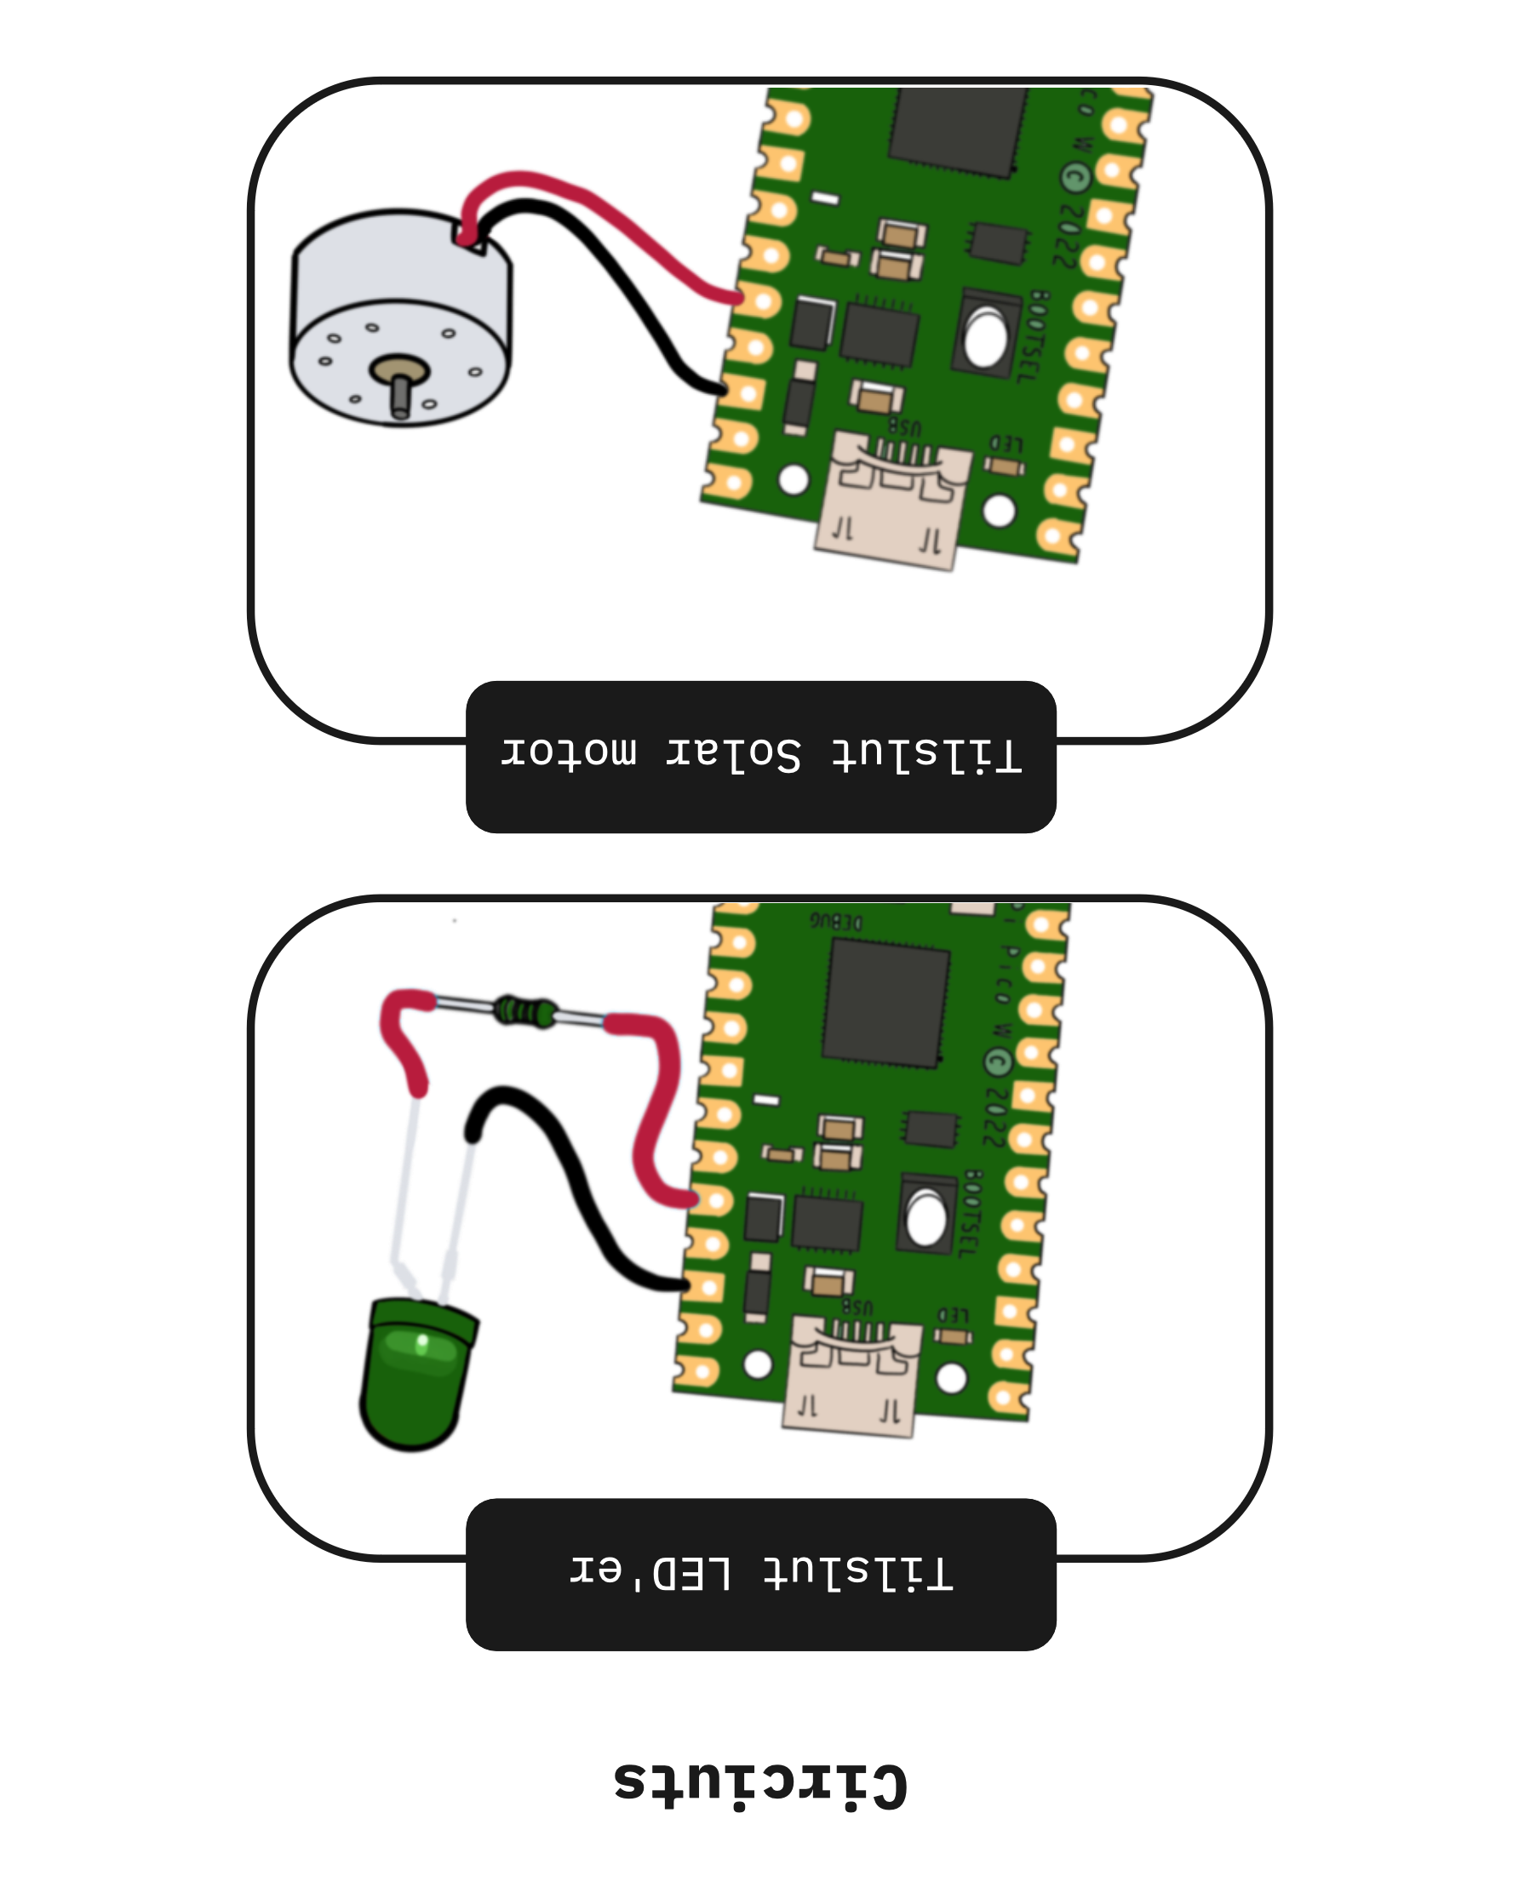
Circuits (Strøm)
Notes:
import machine >>> import time >>> pin = machine.Pin(0, machine.Pin.OUT) >>> for i in range(10): ... pin.on() ... time.sleep(0.5) ... pin.off() ... time.sleep(0.5)

Slide 12
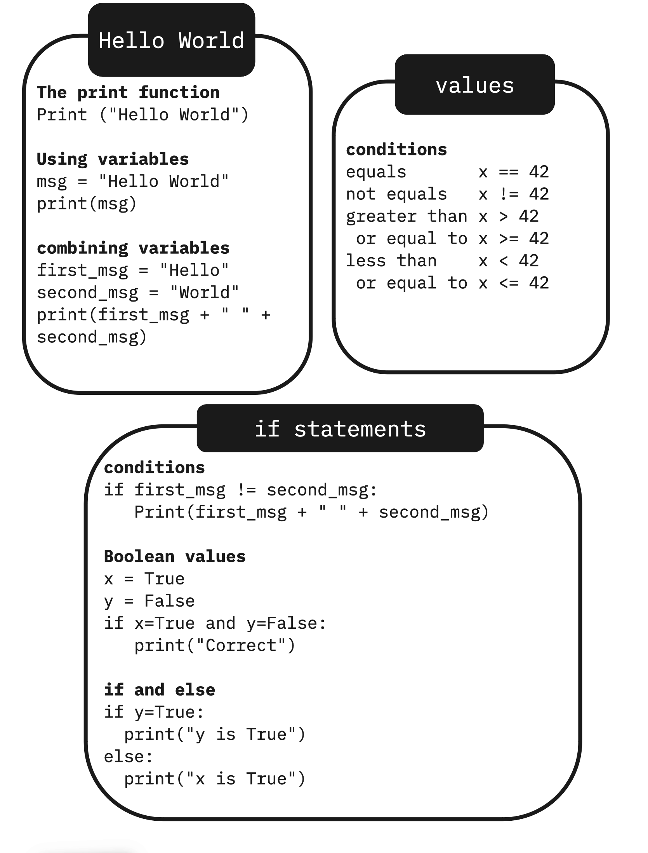
Hello World (python programmering)

Slide 13
Skriv en kode der skriver: ”NaNaNaNaNaNaNaNa Batman”

Slide 14
Pause NU Tilbage kl 12 til: Oplæg Pernille Bjørn, Professor på datalogisk institut Kvinden ”bag” FemTech

Slide 15
Pause nu: tilbage kl 13:10

Slide 16
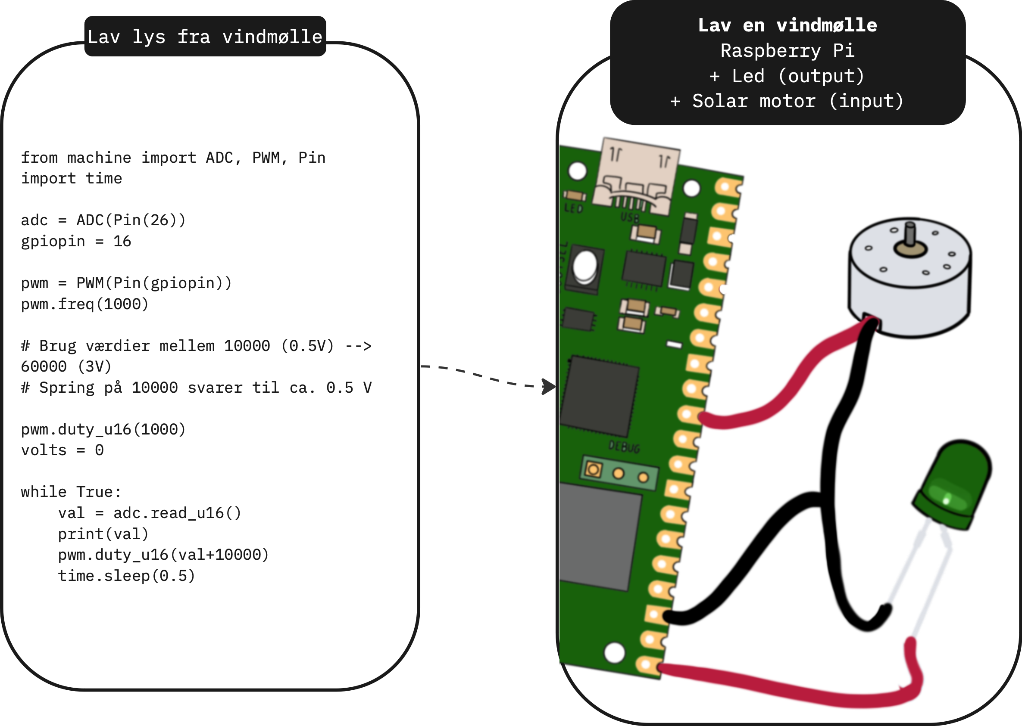
Lav en vindmølle
I skal bruge:
- Flamingo kugle
- 3D modeller
- Sugerør
- Lim, saks, farver
I har allerede:
- Raspberry Pi (+ stik)
- LED
- Motor

Slide 17
Velkommen til
Dag 2

Slide 18
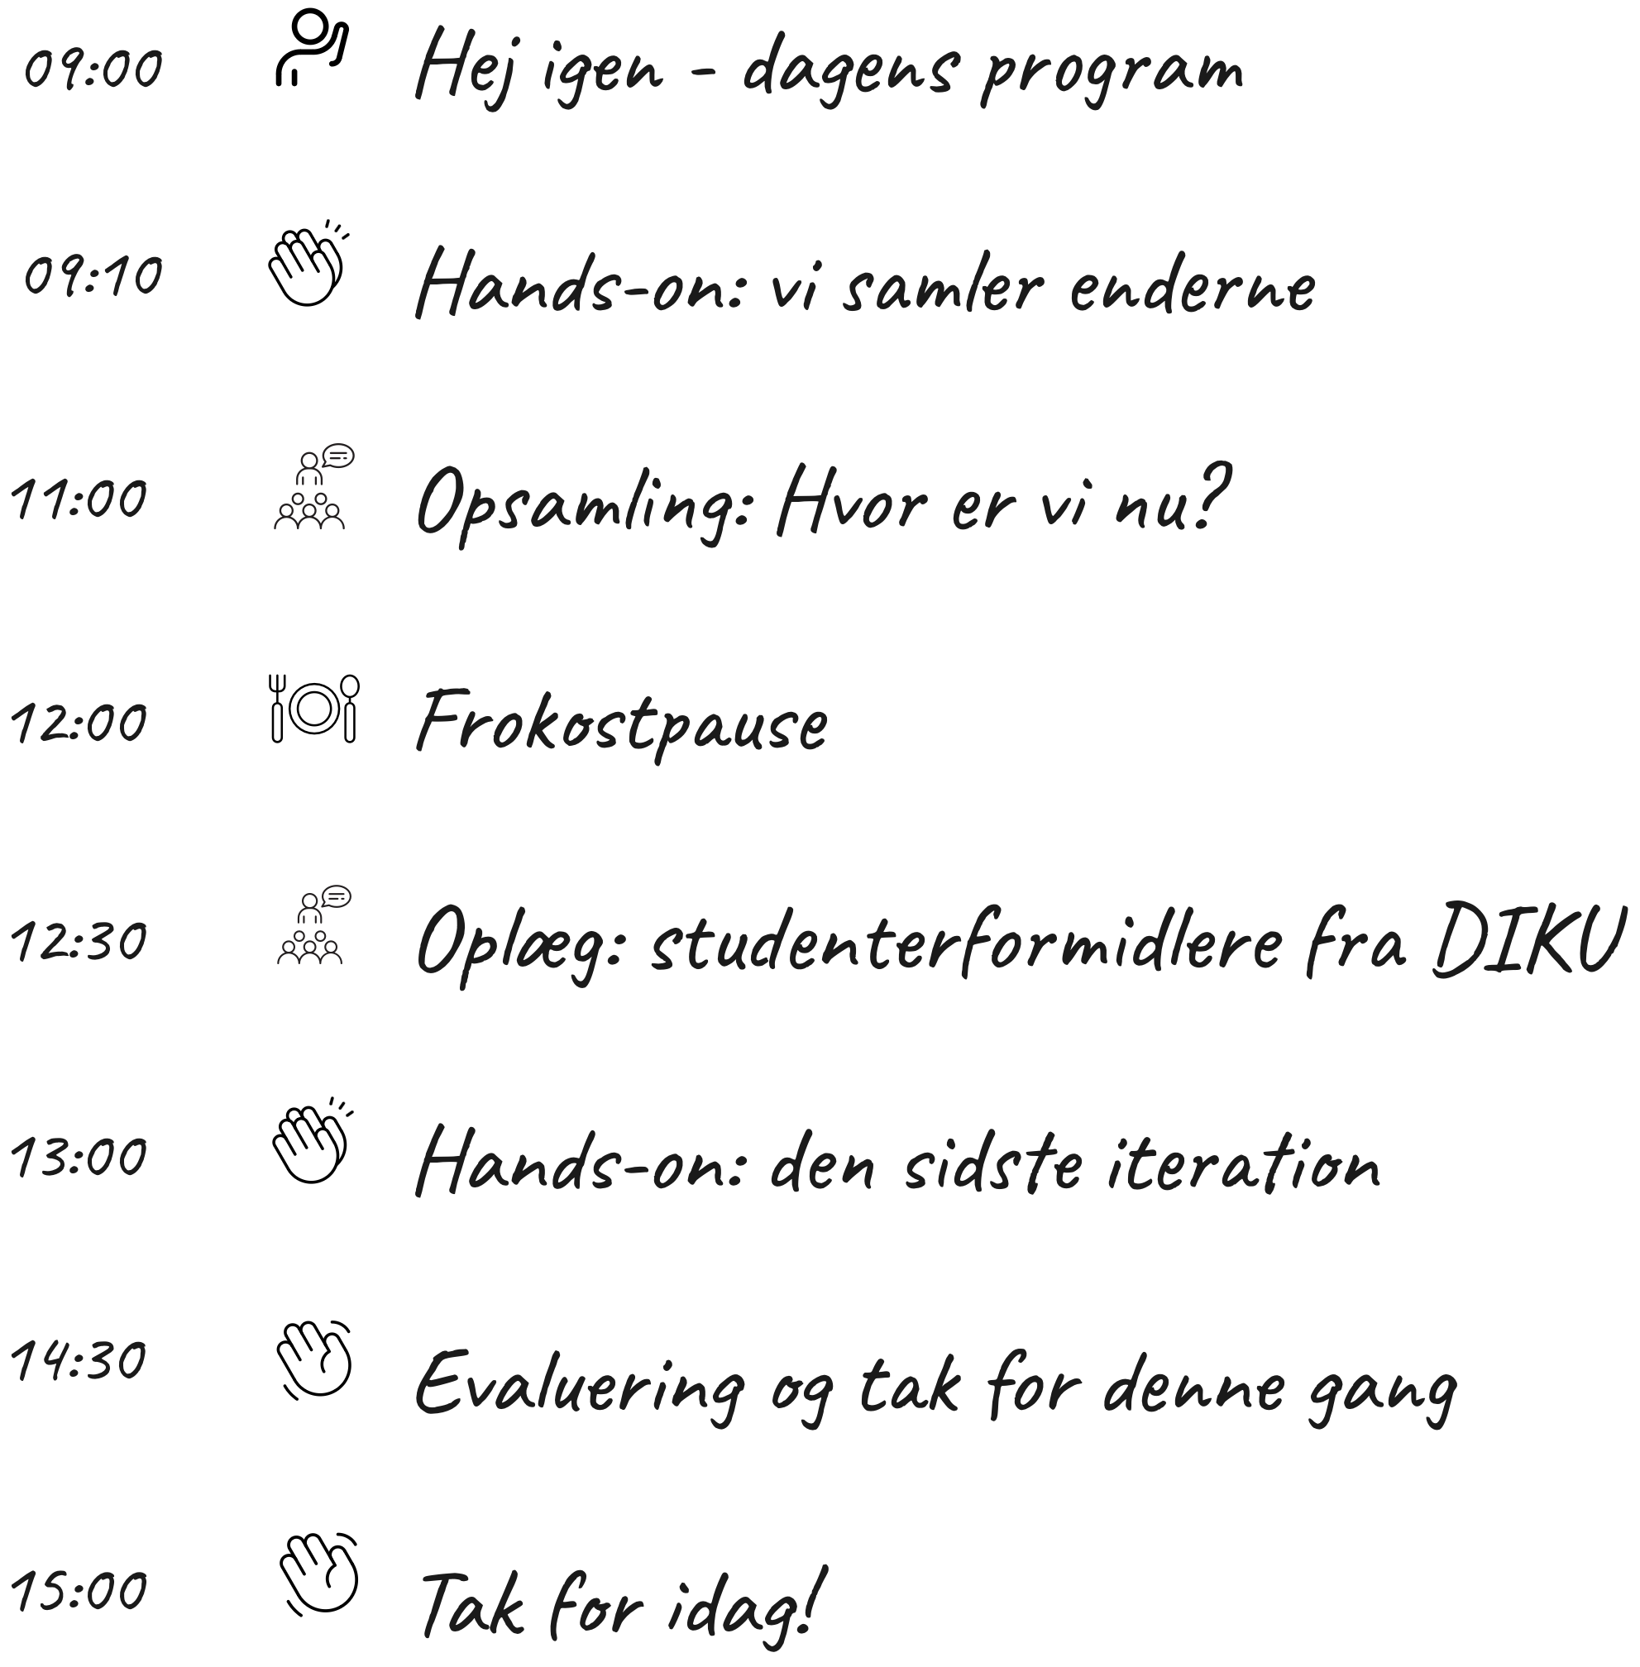
Tidsplan dag 2

Slide 19
HVAD ER WEB API?
Application Programming Interface
VEJR APP
REJSE BOOKING
Google er ikke i vejrdatabranchen (endnu!), så de får det fra en tredjepart. De gør det ved hjælp af en API, som giver dem de seneste meteorologiske oplysninger i et format, som de nemt kan ændre
Brug af tredjeparts API'er til at hente flyselskabs- og hoteltilgængelighed fra leverandører. På samme måde, hvis du bestiller en rejse gennem en af disse tjenester, vil de bruge API'er til at bekræfte rejsen med den leverandør, som den blev hentet fra.
“LOG IN MED FACEBOOK”
They foster connections between technologies to enhance user experience.
LÅNER GOOGLE MAPS
Når brugeren bekræfter at de vil logge ind ved brug af Facebook, sender API'en identitetsoplysninger til applikationen og fortæller den, hvem der logger ind.
Rejsefirmaer elsker auto-udfyld-adresse-funktionerne, som giver deres kunder mulighed for hurtigt at indtaste destinationer for rutevejledninger og alternative ruter og funktionerne "steder i nærheden".
PAYPAL
FEMTECH (OS)
Betal med PayPal"-funktionaliteten, som at tjekke ind med et socialt medie, udføres via API'er for at sikre, at slutapplikationen kun kan gøre, hvad den skal udføre uden at blive udsat for følsomme data eller få adgang til uvelkomne privilegier.
Klimadata der kommer fra Energi Data Service, der har gjort det muligt at hente deres data og ovenikøbet skræddersy den data man gerne vil have før man henter den via et API. Det bruger vi da i vores kode til at skabe et visult output vi selv skal bestemme.
Notes:
https://stackoverflow.com/questions/26830431/web-service-differences-between-rest-and-rpc
https://www.reddit.com/r/technology/comments/5lwwcq/what_is_an_api_in_english_please/

Slide 20
Energidataservice.dk
https://www.energidataservice.dk/tso-electricity/ElectricityProdex5MinRealtime

Slide 21
ENERGI I 2023 SO FAR
15%
146%
121%
33%
46 DAGE
STØRSTE ANDEL AF FORBRUGET
Hvor sol og vindenergi overstiger forbruget
Produceret af sol og vindenergi, d. 3. juli
VINDRIG DAG
SOLRIG DAG
20. februar
8. Juli
Kilde: ENERGINET, Nøgletal om den grønne omstilling
https://energinet.dk/energidata/status-pa-gron-energi/nogletal-om-den-gronne-omstilling/

Slide 22
https://github.com/SaraBoline/Femtech

Slide 23
LAD OS KODE
KODEN 1
FORKLARINGER
import network
import urequests
import time
# Initier WiFi
wlan = network.WLAN(network.STA_IF)
wlan.active(True)
# Autorisation
ssid = ''
password = ''
#wlan.scan()
wlan.connect(ssid, password)
01
import – er en kommando man burger til at importere et biblotek
02
network, urequest, time er alle biblioteker med nogle protokoller i
03
ssid = ‘’ og password = ‘’ bruges til at connecte wifi VARIABLER
04
True – Variable som vi snakkede om igår

Slide 24
LAD OS KODE
KODEN 2
FORKLARINGER
while True:
# API: hent data fra EnergiNet
url = 'https://api.energidataservice.dk/dataset/PowerSystemRightNow?limit=5'
response = urequests.get(url)
result = response.json()
records = result.get('records', [])
# definere værdier
for record in records:
tidspunkt = record['Minutes1DK']
dele = tidspunkt.split("T")
tidspunkt = dele[1]
solenergi = record['SolarPower']
vindenergi = record['OffshoreWindPower'] + record['OnshoreWindPower']
forssileenergi= record ['ProductionGe100MW'] + record ['ProductionLt100MW']
01
While – loop - ”så længe”
02
[] og x.split() – kommando
03
for x in xs – for hver x i alle x’erne
04
Variabler og = definere variabler

Slide 25
LAD OS KODE
KODEN 3
FORKLARINGER
print("Solenergi:", solenergi)
print("Vindenergi:", vindenergi)
print ("Forssile Brændstoffer: ", forssileenergi)
if solenergi <= vindenergi:
print ("Lige nu", tidspunkt ,"producerer vi mere VINDENERGI end solenergi")
else:
print ("Lige nu", tidspunkt ,"producerer vi mere SOLENERGI end vindenergi")
if (solenergi + vindenergi) >= forssileenergi:
print("Vi producere mest GRØN energi")
else:
print ("Vi producere mest SORT energi")
time.sleep(60)
01
print() – “vis mig”
02
if – ”hvis”
03
else- ”ellers”
04
time.sleep()- ”vent”

Slide 26
Hente energidata gennem API
[Indsæt link til noget kode]
Kunne være en fordel fremfor at de skal skrive af, evt uden kommentarer så de kan lave det mens vi gennemgår det??

Slide 27
Oplæg: Studenterformidlere Hvordan er det at gå på KU?

Slide 28
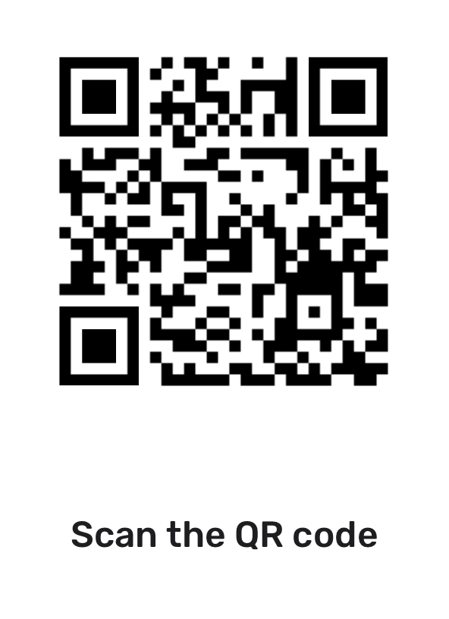
MIT PROJEKT OM CHATGPT

Slide 29
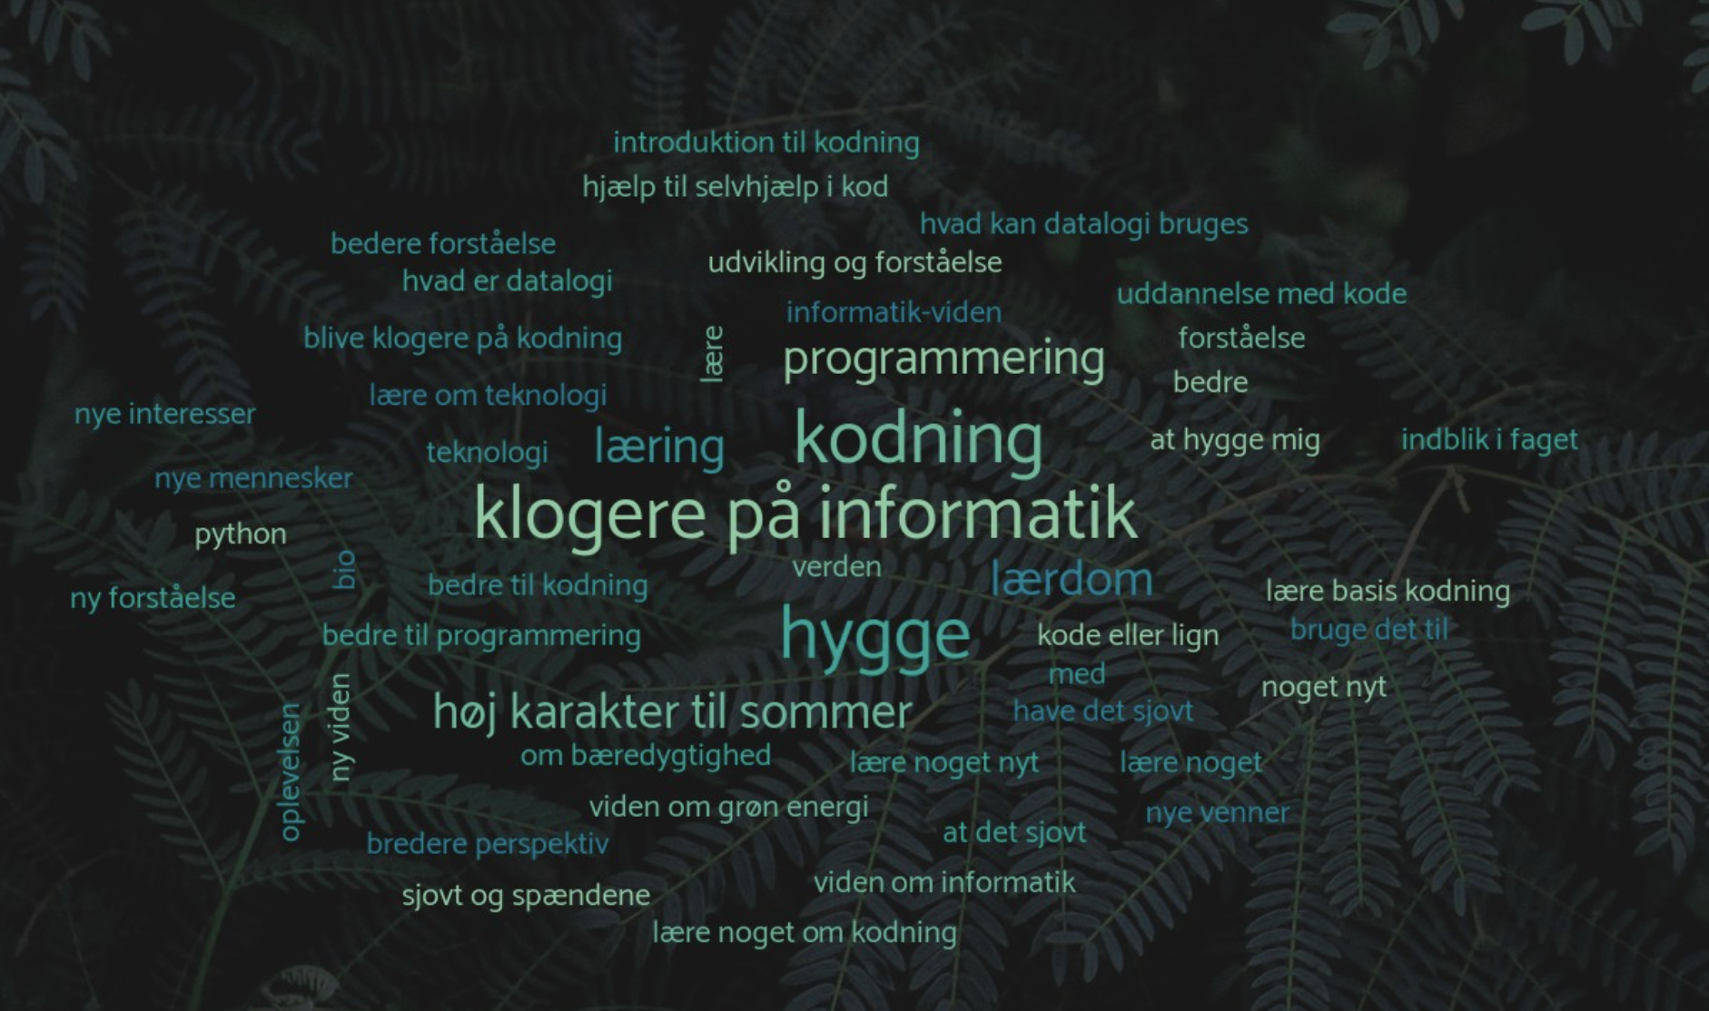

Slide 30
NOGET OM ENERGI
GENDER
AGE
18-23
40%
24-26
60%
INTERESTS
FEMALE
MALE
OTHER
70%
25%
5%
Travel
Nature
Art
Food
Family
Books
Earth is where we all live on
Saturn has several rings
Jupiter is a huge planet

Slide 31
UNIVERSITY MARKETING CAMPAIGN INFOGRAPHICS
CONSUMER
Saturn was named after a Roman god
DISTRIBUTOR
RETAILERS
CONSUMER
Earth is where we all live on
Neptune is far away from the Sun
Mercury is a very small planet
WHOLESALER
RETAILERS
CONSUMER
Jupiter is the biggest planet
Despite being red, Mars is very cold
Venus has a beautiful name

Slide 32
UNIVERSITY MARKETING CAMPAIGN INFOGRAPHICS
EARTH
SATURN
JUPITER
MARS
It’s the planet with life
Saturn has several rings
Jupiter is a huge planet
Mars is a very cold place

Slide 33
UNIVERSITY MARKETING CAMPAIGN INFOGRAPHICS
SATURN
MARS
Saturn is a gas giant with rings
Mars is actually a very cold place
NEPTUNE
MERCURY
Neptune is far away from us
Mercury is the smallest planet

Slide 34
UNIVERSITY MARKETING CAMPAIGN INFOGRAPHICS
 | STEP 1 | STEP 2 | STEP 3 | STEP 4
Mercury is a small planet | Yes | Yes | No | Yes
Saturn has many rings | No | Yes | No | No
Jupiter is a huge planet | No | No | Yes | Yes
Mars is a very cold place | No | Yes | Yes | No

Slide 35
HVAD ER ET WEB API?
VENUS
MARS
Venus is the second planet from the Sun
JUPITER
Mars is actually a very cold place
SATURN
Jupiter is the biggest planet
Saturn is a gas giant with rings

Slide 36
UNIVERSITY MARKETING CAMPAIGN INFOGRAPHICS
JUPITER
VENUS
Jupiter is the biggest planet
Venus is the second planet from the Sun
SATURN
MARS
NEPTUNE
Saturn is a gas giant with rings
Mars is actually a very cold place
Neptune is far away from us

Slide 37
UNIVERSITY MARKETING CAMPAIGN INFOGRAPHICS
SATURN
VENUS
Saturn is a gas giant with rings
Venus is the second planet from the Sun
MARS
Mars is actually a very cold place

Slide 38
UNIVERSITY MARKETING CAMPAIGN INFOGRAPHICS
10%
20%
30%
40%
EARTH
SATURN
JUPITER
MARS
It’s the planet with life
Saturn has several rings
Jupiter is a huge planet
Mars is a very cold place

Slide 39
UNIVERSITY MARKETING CAMPAIGN INFOGRAPHICS
VENUS
Venus is the second planet from the Sun
SATURN
MARS
Saturn is a gas giant with rings
Mars is actually a very cold place

Slide 40
UNIVERSITY MARKETING CAMPAIGN INFOGRAPHICS
GOALS
SHORT TERM
MID TERM
LONG TERM
Venus is extremely hot, even much more than Mercury
Saturn is a gas giant. It was named after a Roman god
Despite being red, Mars is actually a cold place

Slide 41
UNIVERSITY MARKETING CAMPAIGN INFOGRAPHICS
 | 9-10am | 11-12pm | 1-2pm | 2-3pm | 4-5pm | 6-7pm
MON | History | Ethics | Projects | Philosophy | Math | Politics
TUE | Math | Philosophy | History | Politics | Ethics | Projects
WED | Philosophy | Projects | Projects | Politics | History | Math
THU | Ethics | Politics | Philosophy | History | Math | Math
FRI | Politics | Projects | Ethics | History | Philosophy | Philosophy

Slide 42
UNIVERSITY MARKETING CAMPAIGN INFOGRAPHICS
EARTH
PLUTO
NEPTUNE
MERCURY
JUPITER
VENUS
SATURN
Mercury is the closest planet to the Sun
Jupiter is the biggest planet in the Solar System
Venus has a beautiful name but is very hot
Saturn is a gas giant. It was named after a Roman god

Slide 43
UNIVERSITY MARKETING CAMPAIGN INFOGRAPHICS
01
02
03
04
SATURN
JUPITER
MARS
VENUS
Saturn is a gas giant with rings
Jupiter is the biggest planet
Mars is actually a very cold place
Venus is the second planet from the Sun

Slide 44
UNIVERSITY MARKETING CAMPAIGN INFOGRAPHICS
10%
30%
20%
40%
Venus has a beautiful name and it’s hot
Saturn is a gas giant with several rings
Jupiter is the biggest planet of all
Mercury is the smallest planet of them all

Slide 45
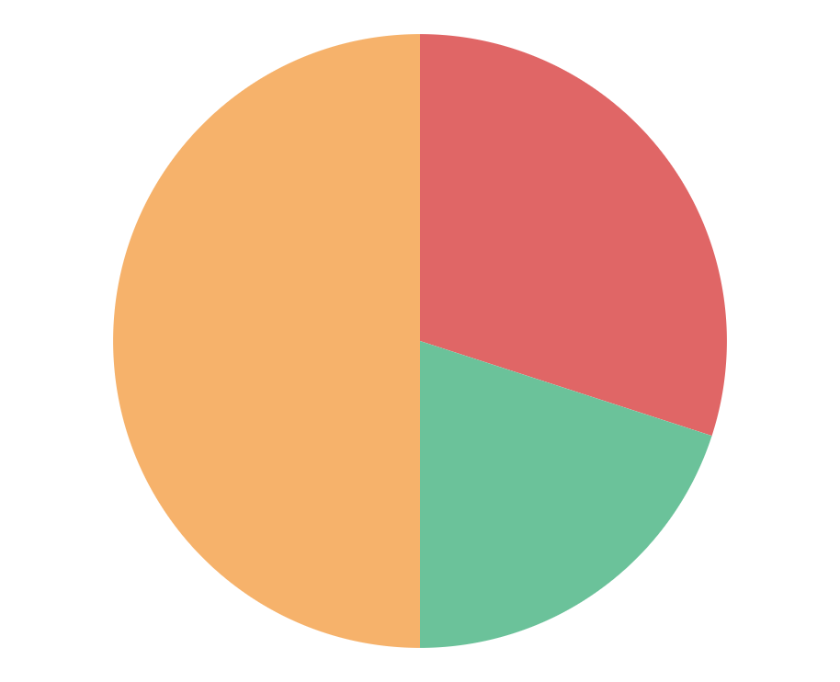
UNIVERSITY MARKETING CAMPAIGN INFOGRAPHICS
VENUS
50%
Venus is the second planet from the Sun
MARS
30%
Mars is actually a very cold place
MERCURY
20%
Mercury is the smallest planet
Follow the link in the graph to modify its data and then paste the new one here. For more info, click here

Slide 46
UNIVERSITY MARKETING CAMPAIGN INFOGRAPHICS
VENUS
Venus is the second planet from the Sun
MARS
Mars is actually a very cold place
MERCURY
Mercury is the smallest planet

Slide 47
UNIVERSITY MARKETING CAMPAIGN INFOGRAPHICS
STEP 1
STEP 2
STEP 3
Venus is the second planet from the Sun
Jupiter is the biggest planet of them all
Saturn is a gas giant and has several rings
STEP 4
STEP 5
STEP 6
Neptune is the farthest planet from the Sun
Mars is actually a very cold place
Earth is also known as the Blue Planet

Slide 48
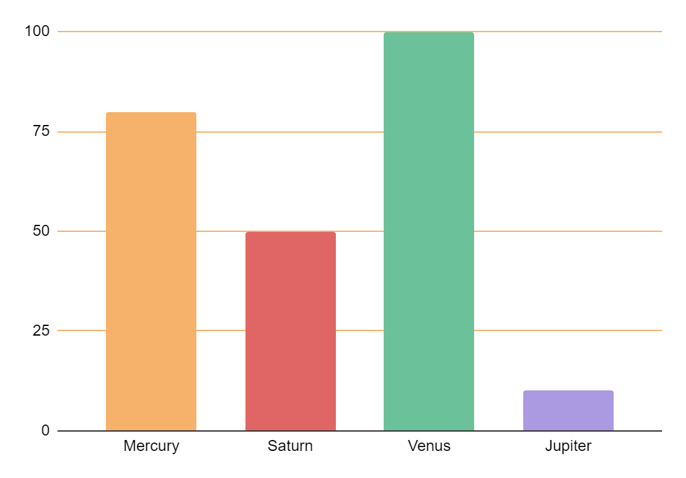
UNIVERSITY MARKETING CAMPAIGN INFOGRAPHICS
MARS
80%
Mars is a cold place
SATURN
50%
Saturn is a gas giant
PLUTO
100%
Pluto is a dwarf planet
JUPITER
10%
Jupiter is a big planet
Follow the link in the graph to modify its data and then paste the new one here. For more info, click here

Slide 49
UNIVERSITY MARKETING CAMPAIGN INFOGRAPHICS
COMPETITORS
STRENGTHS
WEAKNESSES
You can list your competitor’s strengths here
You can list your competitor’s strengths here
You can list your competitor’s strengths here
You can list your competitor’s strengths here
You can list your competitor’s weaknesses here
You can list your competitor’s weaknesses here
You can list your competitor’s weaknesses here
You can list your competitor’s weaknesses here

Slide 50
UNIVERSITY MARKETING CAMPAIGN INFOGRAPHICS
MERCURY
VENUS
Mercury is the closest planet to the Sun and the smallest one in the Solar System
Venus has a beautiful name and is the second planet from the Sun. It’s terribly hot
40%
60%

Slide 51
UNIVERSITY MARKETING CAMPAIGN INFOGRAPHICS
MERCURY
SATURN
Mercury is a very small planet
Saturn is a gas giant with several rings
JUPITER
VENUS
Jupiter is the biggest planet of all
Venus is the second planet from the Sun
EARTH
MARS
Earth is the planet where we live
Despite being red, Mars is very cold
NEPTUNE
PLUTO
Neptune is far away from us
It’s now considered a dwarf planet

Slide 52
ALTERNATIVE ICONS

Slide 53
Instructions for use
If you have a free account, in order to use this template, you must credit Slidesgo in your final presentation. Please refer to the next slide to read the instructions for premium users.
As a Free user, you are allowed to:
- Modify this template.
- Use it for both personal and commercial projects.
You are not allowed to:
- Sublicense, sell or rent any of Slidesgo Content (or a modified version of Slidesgo Content).
- Distribute Slidesgo Content unless it has been expressly authorized by Slidesgo.
- Include Slidesgo Content in an online or offline database or file.
- Offer Slidesgo templates (or modified versions of Slidesgo templates) for download.
- Acquire the copyright of Slidesgo Content.
For more information about editing slides, please read our FAQs or visit our blog:
https://slidesgo.com/faqs and https://slidesgo.com/slidesgo-school

Slide 54
Instructions for use (premium users)
As a Premium user, you can use this template without attributing Slidesgo.
You are allowed to:
Modify this template.
Use it for both personal and commercial purposes.
Share this template in an editable format with people who are not part of your team.
You are not allowed to:
Sublicense, sell or rent this Slidesgo Template (or a modified version of this Slidesgo Template).
Distribute this Slidesgo Template (or a modified version of this Slidesgo Template) or include it in a database or in any other product or service that offers downloadable images, icons or presentations that may be subject to distribution or resale.
Use any of the elements that are part of this Slidesgo Template in an isolated and separated way from this Template.
Register any of the elements that are part of this template as a trademark or logo, or register it as a work in an intellectual property registry or similar.
For more information about editing slides, please read our FAQs or visit our blog:
https://slidesgo.com/faqs and https://slidesgo.com/slidesgo-school

Slide 55
Infographics
You can add and edit some infographics to your presentation to present your data in a visual way.
Choose your favourite infographic and insert it in your presentation using Ctrl C + Ctrl V or Cmd C + Cmd V in Mac.
Select one of the parts and ungroup it by right-clicking and choosing “Ungroup”.
Change the color by clicking on the paint bucket.
Then resize the element by clicking and dragging one of the square-shaped points of its bounding box (the cursor should look like a double-headed arrow). Remember to hold Shift while dragging to keep the proportions.
Group the elements again by selecting them, right-clicking and choosing “Group”.
Repeat the steps above with the other parts and when you’re done editing, copy the end result and paste it into your presentation.
Remember to choose the “Keep source formatting” option so that it keeps the design. For more info, please visit our blog.

