Slide 1
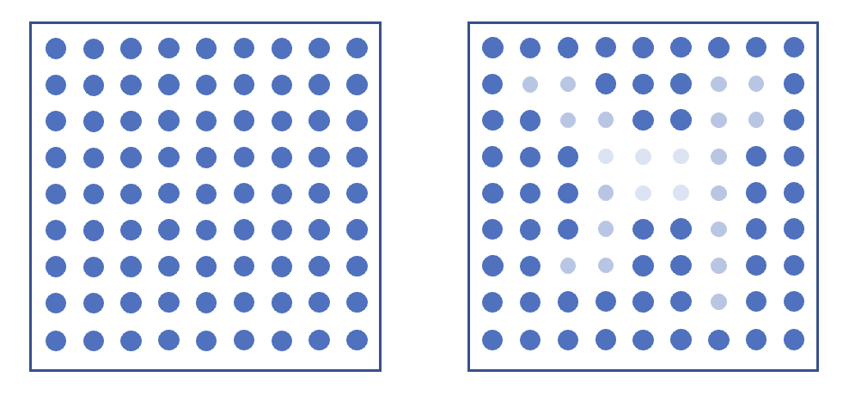

Slide 2
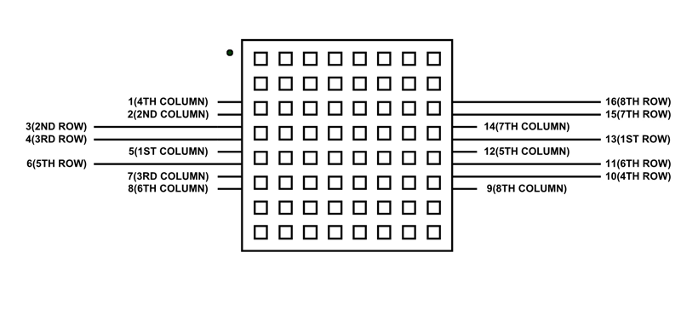
https://components101.com/displays/8x8-led-matrix-module

Slide 3
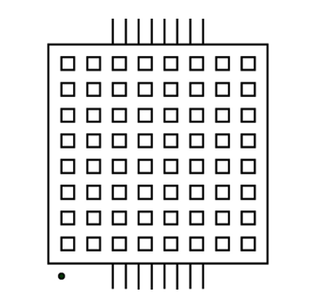
V₋
16 | 15 | 14 | 13 | 12 | 11 | 10 | 9
9,13 | 9 | 9 | 9 | 9 | 9 | 9 | 9
14 | 14 | 14 | 14 | 14 | 14 | 14,15 | 14
8 | 8 | 8 | 8 | 8 | 8 | 8 | 8
12 | 12 | 12 | 12 | 12 | 12 | 12 | 12
1,13 | 1,3 | 1,4 | 1,10 | 1,6 | 1,11 | 1,15 | 1,16
7 | 7 | 7 | 7 | 7 | 7 | 7 | 7
2 | 2 | 2 | 2 | 2 | 2 | 2 | 2
5 | 5 | 5 | 5 | 5 | 5,13 | 5 | 5
V₊
V₋
V₊
1 | 2 | 3 | 4 | 5 | 6 | 7 | 8

Slide 4
V₋
Kolonner
16 | 15 | 14 | 13 | 12 | 11 | 10 | 9
9,13 | 9 | 9 | 9 | 9 | 9 | 9 | 9
14 | 14 | 14 | 14 | 14 | 14 | 14,15 | 14
8 | 8 | 8 | 8 | 8 | 8 | 8 | 8
12 | 12 | 12 | 12 | 12 | 12 | 12 | 12
1,13 | 1,3 | 1,4 | 1,10 | 1,6 | 1,11 | 1,15 | 1,16
7 | 7 | 7 | 7 | 7 | 7 | 7 | 7
2 | 2 | 2 | 2 | 2 | 2 | 2 | 2
5 | 5 | 5 | 5 | 5 | 5,13 | 5 | 5
Rækker
V₊
V₋
V₊
1 | 2 | 3 | 4 | 5 | 6 | 7 | 8

Slide 5
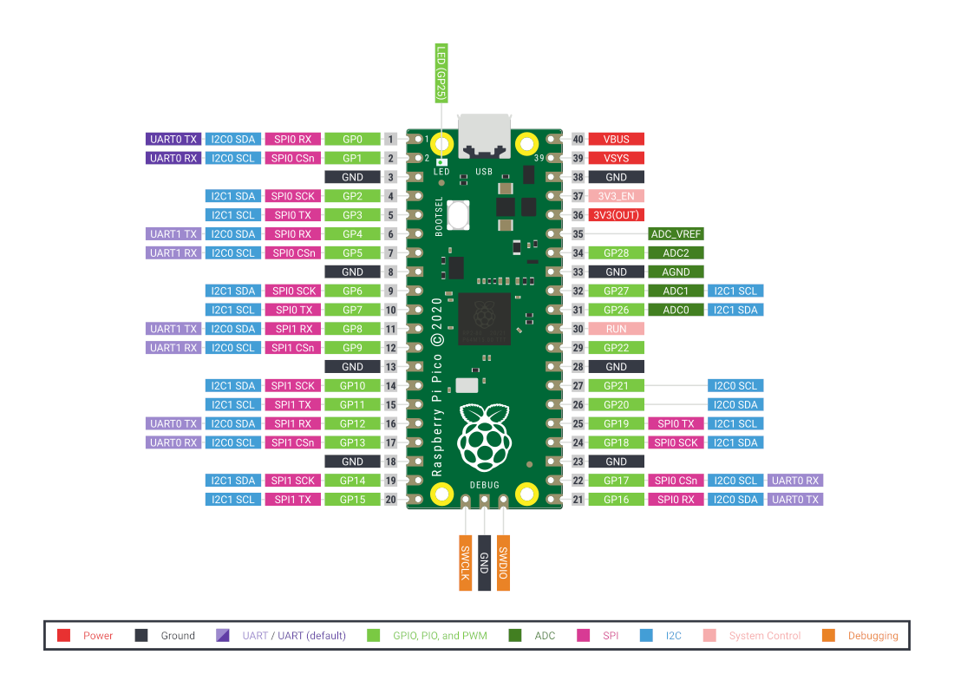

Slide 6
from machine import ADC, Pin
import time
# ROWS
R1 = 18
R2 = 17
R3 = 19
R4 = 16
R5 = 14
R6 = 26
R7 = 15
R8 = 13
#COLUMNS
C1 = 12
C2 = 20
C3 = 21
C4 = 11
C5 = 22
C6 = 10
C7 = 9
C8 = 8
ldr = machine.ADC(27)
pin_r1 = Pin(R1, mode=Pin.OUT)
pin_r2 = Pin(R2, mode=Pin.OUT)
pin_r3 = Pin(R3, mode=Pin.OUT)
pin_r4 = Pin(R4, mode=Pin.OUT)
pin_r5 = Pin(R5, mode=Pin.OUT)
pin_r6 = Pin(R6, mode=Pin.OUT)
pin_r7 = Pin(R7, mode=Pin.OUT)
pin_r8 = Pin(R8, mode=Pin.OUT)
pin_c1 = Pin(C1, mode=Pin.OUT)
pin_c2 = Pin(C2, mode=Pin.OUT)
pin_c3 = Pin(C3, mode=Pin.OUT)
pin_c4 = Pin(C4, mode=Pin.OUT)
pin_c5 = Pin(C5, mode=Pin.OUT)
pin_c6 = Pin(C6, mode=Pin.OUT)
pin_c7 = Pin(C7, mode=Pin.OUT)
pin_c8 = Pin(C8, mode=Pin.OUT)

Slide 7
rows = [pin_r1, pin_r2, pin_r3, pin_r4, pin_r5, pin_r6, pin_r7, pin_r8]
cols = [pin_c1, pin_c2, pin_c3, pin_c4, pin_c5, pin_c6, pin_c7, pin_c8]
def light_all():
for p in rows:
p.value(1)
for p in cols:
p.value(0)
def turn_off_all():
for p in rows:
p.value(0)
for p in cols:
p.value(0)
row = 0
turn_off_all()
ldr_vals = []
turn_off_all()
time.sleep(1)
for i in range(len(cols)):
print(f'Turning on: cols[{i}]')
cols[i].value(0)
turn_off_all()
rows[i].value(1)
print(f'Reading LDR values: {ldr.read_u16()}')
time.sleep(1)
turn_off_all()

Slide 8
turn_off_all()
for i in range(len(rows)):
for j in range(len(cols)):
for r in rows:
r.value(0)
rows[i].value(1)
for c in cols:
c.value(1)
cols[j].value(0)
ldr_val = ldr.read_u16()
ldr_vals.append(ldr_val)
time.sleep(0.5)
cols[j].value(1)
time.sleep(0.5)
print('Contents of ldr_vals[]: ', ldr_vals)
print('Number of values: ', len(ldr_vals))

Slide 9
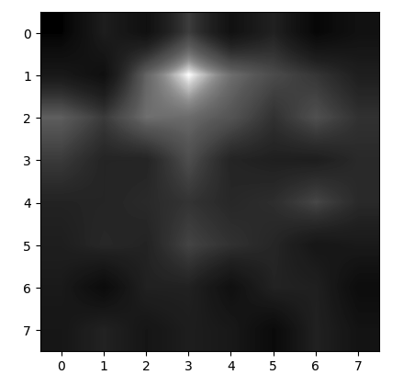
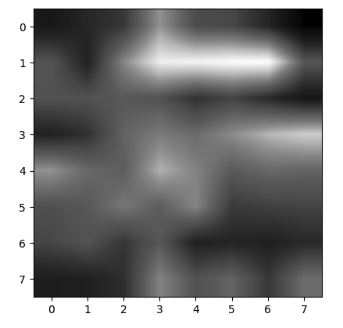

Slide 10
